Slide 1
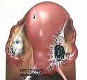
Endometriosis Presence of endometrial tissue (glands & stroma) outside the uterus which induces chronic inflammatory reaction Affects general physical, mental & social well being. Endometriosis

Slide 2
Presence of endometrial tissue (glands & stroma) outside the uterus
___________________________________________________
It is a progressive debilitating disease affecting general physical, mental & social well being of women
___________________________________________________
Affects nearly 7 to10% of the women in reproductive age, 30% of those who are infertile or present with pain.
___________________________________________________
The most frequent sites of implantation are pelvic viscera and the peritoneum
___________________________________________________
Less commonly cervix, hernial sacs, the umbilicus, laparotomy or episiotomy scars may be involved

Slide 3
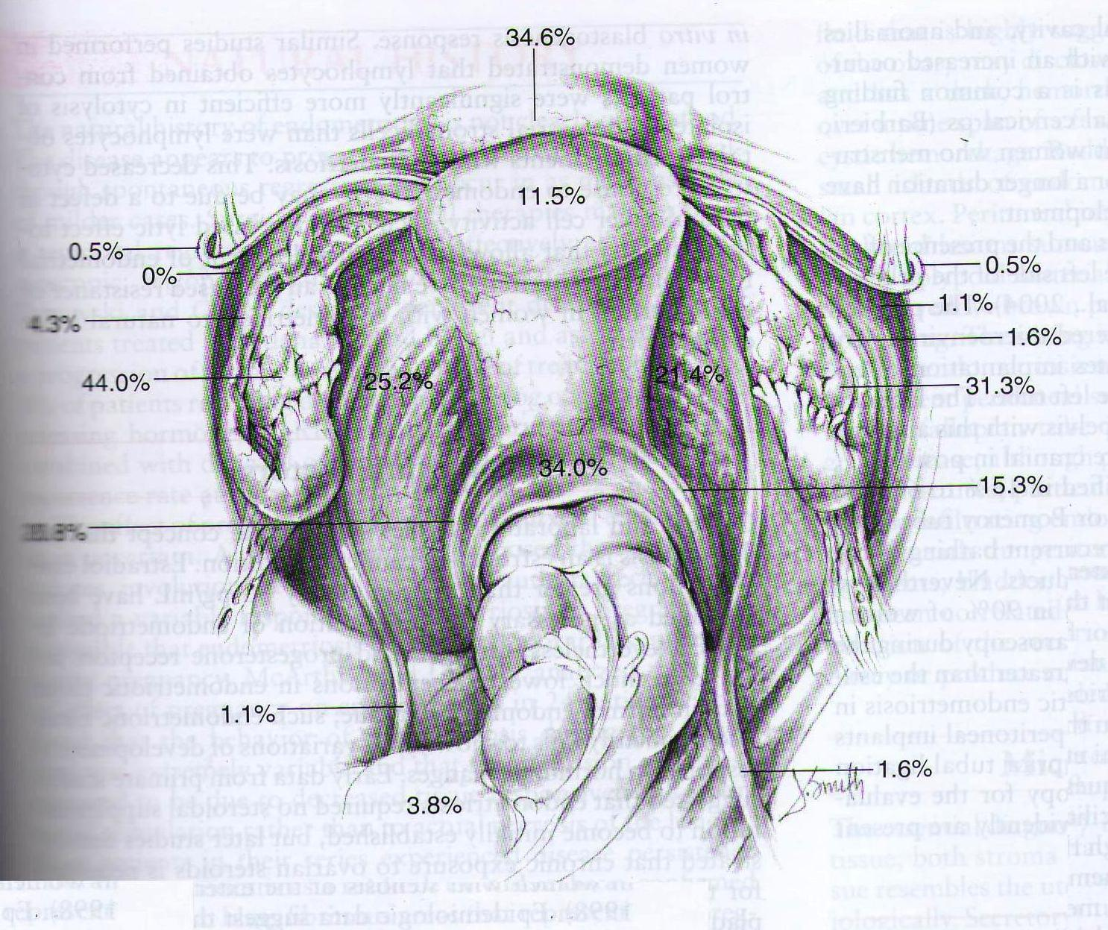

Slide 4
Sites of endometriosis
Pelvic
Ovary
Cul de sac
Uterosacrals
Posterior surface of uterus
Posterior broad ligament
Rectovaginal septum
Tubes and round ligaments
Extrapelvic sites
Intestines (rectosigmoid, cecum, terminal ileum, proximal colon, appendix)
Lungs & thorax
Urinary tract
Less common sites
Cervix
Hernial sacs
Umblicus
Laparotomy/episiotomy sites
Tubal stumps after sterilization
Rarest
Extremities

Slide 5
Why Newer Concepts are required
First described by Daniel Shroen in 1690 but still we are not very sure of its definitive cause
Endometriosis is considered to be an enigmatic disease owing to
Lack of specific symptoms,
Poorly understood pathogenesis
Limited effective therapeutic options
The last three decades have witnessed a significant volume of research related to endometriosis
Incidence is increasing b/c of changing life style, increased awareness and better diagnostic modalities

Slide 6
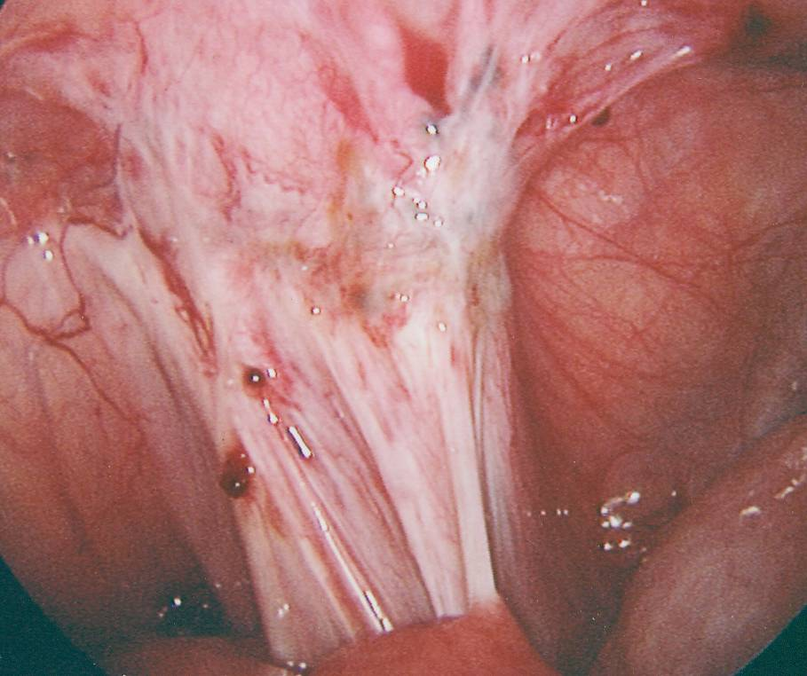
Endometriotic lesions Variable appearance
Peritoneum
Typical
Superficial
Early red lesions
Powder burn or gunshot
Black, dark brown or bluish puckered lesions
White plaques
Adhesions –flimsy,vascular,dense
(DIE) Deeply Infiltrating Endometriosis , >5mm depth
Atypical or subtle lesions
Serous / clear vesicle
Yellowish discoloration
Ovaries
Superficial
Subovarian adhesions
Endometriomas

Slide 7
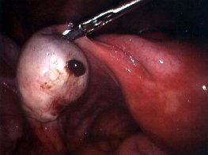
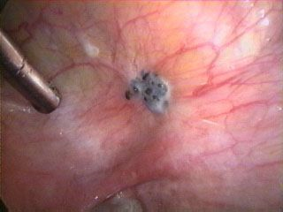
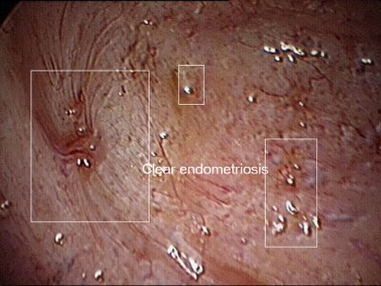
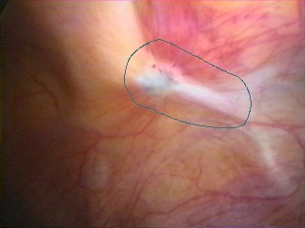

Slide 8
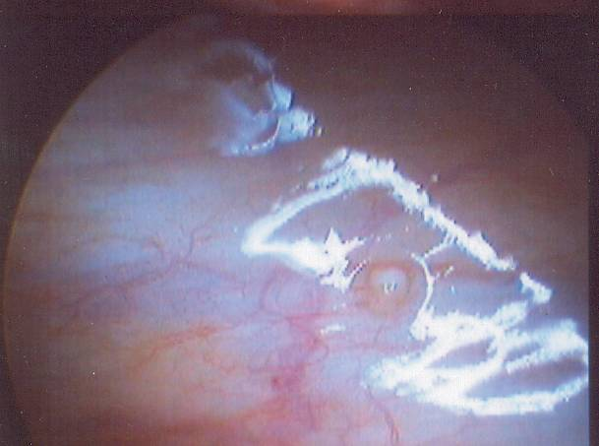
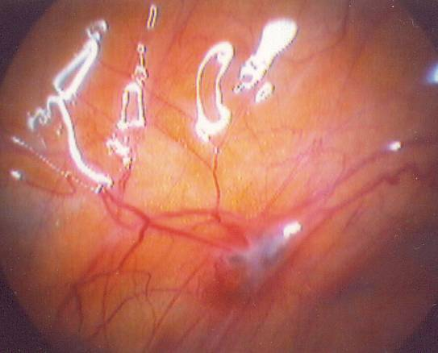
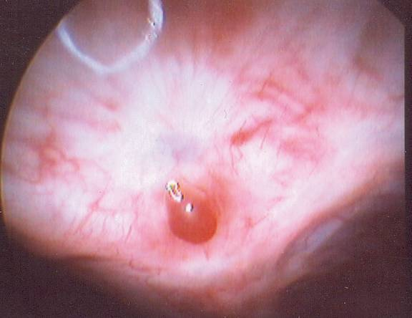
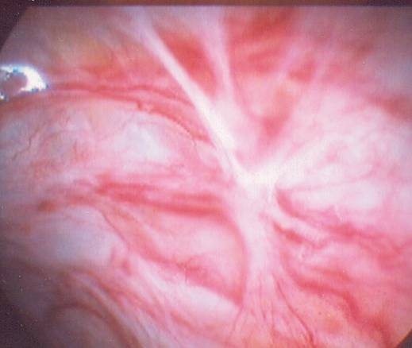

Slide 9
Why does it occur ?
Transplantation theory (Sampson)
Coelomic metaplasia theory(Mayer and Ivanoff)
Induction theory (Merril)
Genetic factors
Immunologic factors
The cellular and molecular etiologic theories label endometriosis as an inflammatory and estrogen dependent disorder

Slide 10
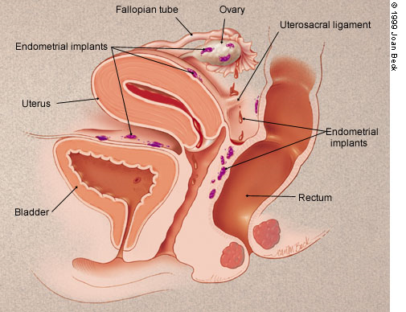
Transplantation theory:
Originally proposed by Sampson in 1920
Based on assumption that endometriosis is caused by implantation of the endometrial cells by transtubal regurgitation during menstruation.
Seen in 70-90% of women , more common in endometriosis

Slide 11
A; androstendione, AA; arachidonic acid, Arom; aromatase P450,E2; estradiol, IL-I β interleukin1 β, TNF- tumor necrosis factor , VEGF; vascular endothelial growth factor
Peritoneal Environment in Endometriosis

Slide 13
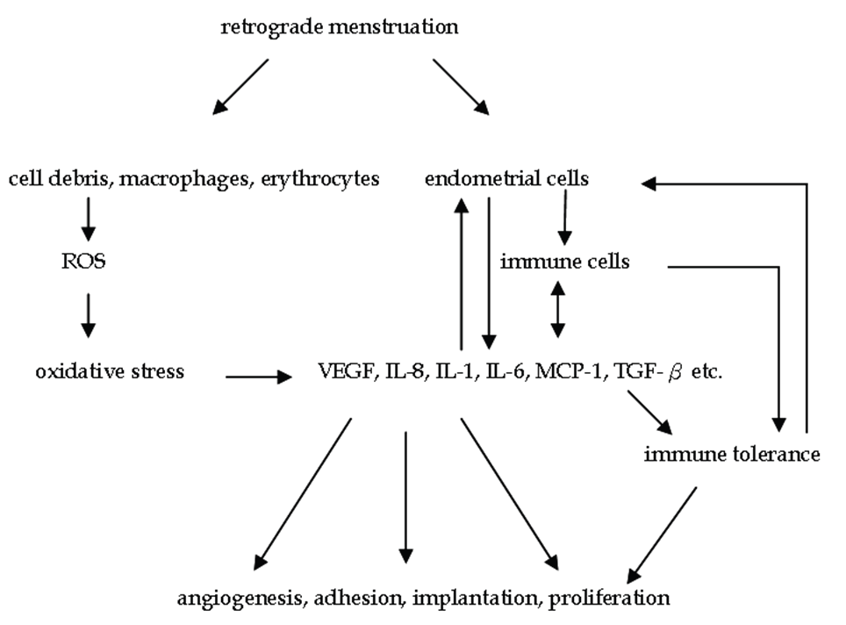

Slide 14
Is It Inherited ?
No Mendelian pattern of inheritance, multi factorial inheritance is suggested.
Risk of endometriosis is 7 times if first degree relative is affected.
75% incidence in monozygotic twins.
No mutations have been identified so far.
Aneuploidy- chromosome 11,16,17, losses of 1p,22q,5p,6q,16,&18 have been demonstrated in endometriotic cells.

Slide 15
Grading of Endometriosis

Slide 16
Endometriosis | Deposits | < 1cm | 1-3 cm | > 3cm
Peritoneal | Superficial | 1 | 2 | 4
 | Deep | 2 | 4 | 8
Ovary | Right superficial | 2 | 4 | 8
 | Right deep | 4 | 16 | 20
 | Left superficial | 2 | 4 | 8
 | Left deep | 4 | 16 | 20
Cul-de-sac obliteration | Partial | 4 | Complete | 40
Adhesions | Enclosure | <1/3 | 1/3-2/3 | >2/3
Ovary | Right filmsy | 1 | 2 | 4
 | Right dense | 4 | 8 | 16
 | Left filmsy | 1 | 2 | 4
 | Left dense | 4 | 8 | 16
Tube | Right filmsy | 1 | 2 | 4
 | Right dense | 4 | 8 | 16
 | Left filmsy | 1 | 2 | 4
 | Left dense | 4 | 8 | 16

Slide 17
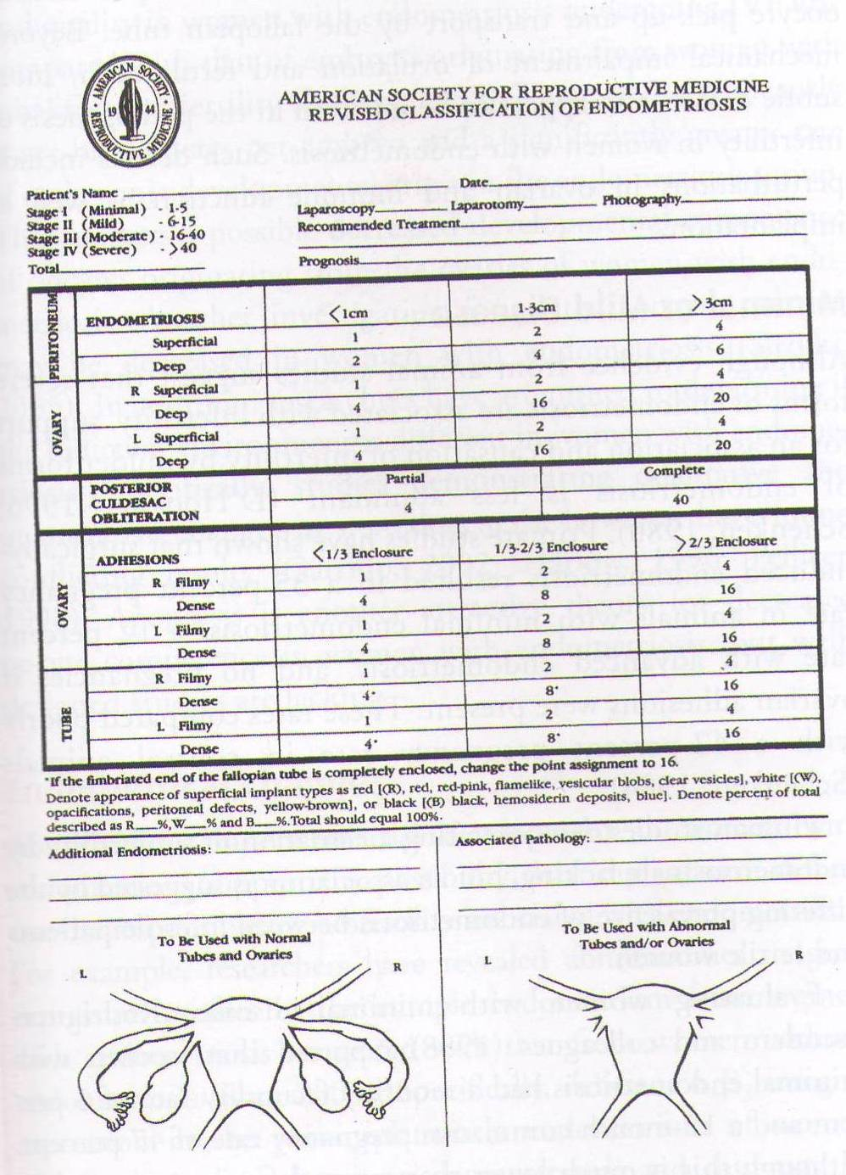

Slide 18
Clinical Presentation
Severe dysmenorrhoea
Deep dyspareunia
Chronic pelvic pain
Ovulation pain
Perimenstural pain/bleed
Infertility
Chronic fatigue
Pain during defecation
Variable
Need high index
of suspicion
Usually delay of many years
b/w
Symptoms and Definitive diagnosis

Slide 19
Dysmenorrhea & pelvic pain-
Often starts after years of pain free menses.
Starts before the onset of periods and continues throughout menses
Most studies failed to show correlation between degree of pain and severity of endometriosis.
Causation of pain –
local peritoneal inflammation,
deep infiltration- proximity to nerve fibers,
adhesion formation and fibrotic thickening,
collection of shed menstrual blood in implants, resulting in painful traction with physiological movements.

Slide 20
Infertility
Possible mechanisms
Mechanical causes
Altered tubo ovarian relationships
Altered tubal motility
Impaired oocyte pickup
Alterations in peritoneal fluid
↑Macrophages, PGs, Cytokines - affect sperm motility, sperm oocyte interaction, sperm phagocytosis, implantation failure
Alteration of systemic immune response
↑ antiendometrial antibodies –(Gajbhiye et al 2008,Mathur et al 2000)
↑ cell mediated gametocyte injury

Slide 21
Hormonal factors-
Defective folliculogenesis
Luteinized unruptured follicle (4-35%)
Luteal phase deficiency
Hyperprolactinemia and galactorrhea
Fertilization and implantation failure
Monthly fecundity rate is lower in women with mild disease ( 5-11% vs 25%)
No evidence that spontaneous abortion rates are higher in endometriosis.

Slide 22
.Diagnosis
Pelvic tenderness, a fixed retroverted uterus, tender utero-sacral ligaments or enlarged ovaries suggest endometriosis.
Deeply infiltrating nodules on utero-sacral ligaments/POD or visible lesions on vagina or cervix give more certainty.
The detection is improved if examined during menstruation. Acceptance may be an issue
Rectovaginal examination is required if suspecting DIE.

Slide 23
Diagnosis
For a definitive diagnosis of endometriosis visual inspection of the pelvis at laparoscopy is the gold standard investigation, unless disease is visible in the vagina or elsewhere.(RCOG recommendation level B)
There is insufficient evidence to justify timing the laparoscopy at a specific time in the menstrual cycle but it should not be performed during or within 3 months of hormonal treatment so as to avoid under diagnosis .

Slide 24
Is Histological confirmation necessary ? (RCOG Recommendations)
Positive histology confirms the diagnosis of endometriosis
Negative histology does not exclude it.
Whether histology should be obtained if peritoneal disease alone is present is controversial. Visual inspection is usually adequate but histological confirmation of at least one lesion is ideal.
In case of ovarian endometrioma (more than 3cm) and in deeply infiltrating disease histology should be obtained to identify endometriosis and to exclude rare instances of malignancy.

Slide 25
TVS in diagnosing Endometriosis
Compared to laparoscopy, TVS has limited value in diagnosing peritoneal endometriosis
But it is a useful tool both to make and exclude the diagnosis of ovarian endometrioma. (RCOG level A ,Recomendations.)
TVS may have a role in the diagnosis of disease involving the bladder or rectum
Sensitivity-83% & specificity-98% for endometrioma.

Slide 26
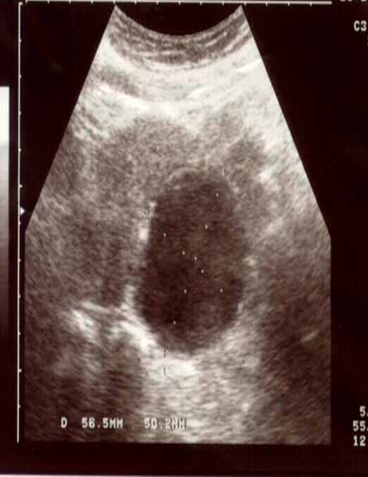
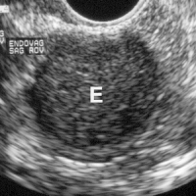
Classical appearance-
homogenous, hypoechoic mass with low levels internal echoes with hyperechoic foci within wall.
95% show internal echoes & hyperechoic lesions are due to cholesterol deposits.
Lesions- unilocular/ moltilocular with thick/thin septa

Slide 27
Differential diagnosis:
Dermoid cyst- acoustic shadowing (calcium) & echogenic lesion (fat).
Hemorrhagic cyst- high levels of internal echoes with thin walled cyst, resolves with time.
Cystic neoplasm
Transrectal ultrasound:
Better resolution, diagnostic accuracy, restricted field of visualization (Distal bowel can be imaged).
Deposits- round hypoechoic, infilteration of bowel wall is seen as thickening of muscularis propria.
Sensitivity-97%, specificity-89% for rectal lesions ( better than MRI).

Slide 28
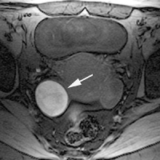
Role of Doppler
Diagnostic accuracy is enhanced by doppler.
Pericystic flow with RI more than 0.45, indicating low resistance waveform.
MRI:
Advantage of imaging entire pelvis in multiple planes.
Particularly useful in evaluating rectum & cul de sac.
Appearance depends upon- iron content, proteins and products of blood degradation.

Slide 29
CA -125
Low sensitivity (25-50%), not used as screening method.
Helpful to predict recurrence.
Levels in non menstrual phase-
Minimal/mild-14-31U/ml
Moderate/severe-13-95U/ml
80% of patients with pelvic pain & raised CA125 levels have endometriosis, while only 6% of those without endometriosis have raised CA125 levels. (Pittaway et al 1989)
High levels of CA-125 have been reported in cases of large endometrioma/ ruptured endometriomas.
(Shiau et al 2008,Kahraman et al 2007,Ghaemmaghami et al 2007,Phuphong et al 2004)

Slide 30
Laparoscopy – gold standard
Diagnose the extent and severity of disease.
Should not be performed within 3 months of hormonal therapy to avoid under diagnosis.
Methodical approach required. Thoroughly inspect the lateral sidewalls, all ovarian surfaces, both sides of broad ligament, bladder, bowel serosa and inferior aspects of the cul de sac.
Uterine manipulation helps in visualizing POD and recto vaginal septum
Photography and video recording of the findings should be done ideally.

Slide 31
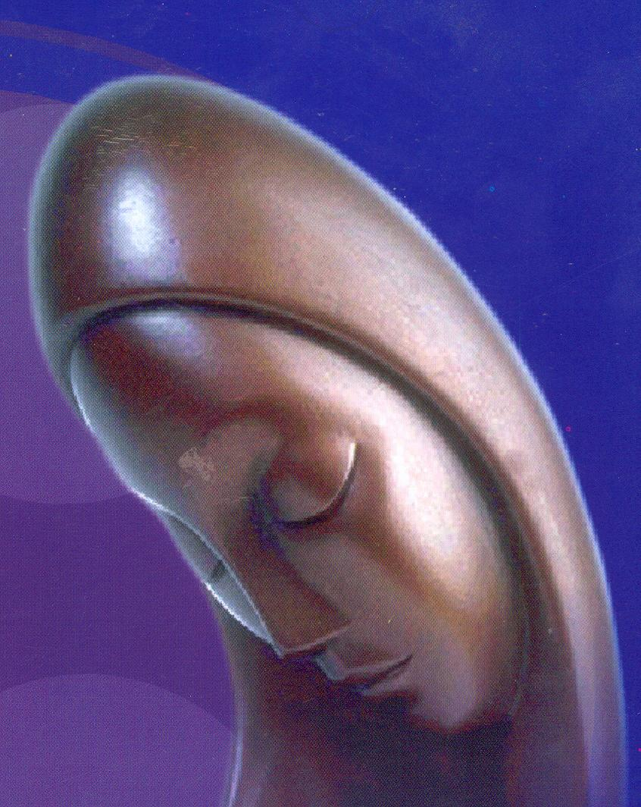
Treatment Options
Medical Therapy
NSAIDs and Cox2 inhibitors
COCs
Progestogens
Anti progestins
GnRH agonists and antagonists
Aromatase inhibitors
Selective Estrogen Receptor Modulators
Selective Progesteron Receptor Modulators
Surgical Treatment
Conservative Surgery
Definitive Surgery

Slide 32
Green-top Guideline No. 24 October 2006 (Minor revisions October 2008)
Inconclusive evidence, if NSAIDs (specifically naproxen ) are effective in managing end. associated pain.(level-A)
Suppression of ovarian function for 6 mths reduces end. associated pain.(level-A)
COCs, MPA, Danazol, Gestrinone and GnRH agonists are equally effective but their adverse effects and cost profiles differ and can be chosen accordingly (level-B)

Slide 33
ACOG recommends 3 months trial of NSAID & cyclic OCP.
If pain persists after 3 months then laparoscopy
If patient > 18 yrs and wish to avoid surgery-empiric GnRHagonists
If pain resolves then diagnosis of endometriosis is confirmed
Any low dose OCP containing 30-35 mg of ethinyl estradiol used continuously (to achieve amenorrhea) can be effective in treatment of endometriosis. (Moghessi et al 1999)
Cyclic OCP is used to provide prophylaxis against either the development or recurrence of endometriosis.
Nuva ring can also be used.

Slide 34
Progesterones(cont)
Drug | Dose
MPA | 30mg | Daily , orally
Norethisterone acetate | 2.5-5mg | Daily, orally
Megesterol | 40mg | Daily , orally
Lynestrenol | 10mg | Daily , orally
Dydrogesterone | 20-30mg | Daily , orally

Slide 35
GnRH Agonist
Causes pseudomenopause by down regulation of pitutary, very effective
Indicated if patient is unable to have an acceptable degree of pain control with COCs. Not to be given if< 17 yrs (ESHRE 2005)
Leuprolide 3.75mg/mth, Gosereline 3.6mg/mth
Buserelin, Nafarelin,Triporelin
Add back therapy
CEE .625 mg+ norethindrone , noreth. alone or tibolone 2.5 mg + 1200 mg of Calcium & Vitamin D daily
Goal of add back – effectively treat endometriosis associated pain while preventing vasomotor symptoms or bone loss.
Treatment up to 2 yrs with COC add back appears to be effective and safe in terms of pain relief and bone density.
GnRH Antagonists

Slide 36
LNG Intra Uterine System
LNG- IUS appears to reduce endometriosis associated pain (RCOG level -A)
Insertion after laparoscopic surgery for endometriosis associated pain, significant reduction in the risk of recurrent moderate–severe dysmenorrhoea at 1 year follow-up.(level A)
Causes significant reduction in pain, dysmenorrhea, dyspareunia and size of rectovaginal endometriosis (upto 3yrs).
It also has minimal systemic effects, effective contraception & long term 5 years of benefit, as compared to 6 mths, typical of GnRHa treatment.
Dienogest ; highly selective PRM, as effective as GnRHa
May prove better option,Now available…2mg continuously

Slide 37
Danazol 400-800 mg/day, first drug approved for end. in US. Adverse side effects limit its use
Gestrinone Causes cellular inactivation and degeneration of endometrial implants.
1.25- 2.5mg twice weekly for 24weeks.
Amenorrhea occurs in 50-100% of cases.
Equally effective, Seems to prove good alternative
Side effects- androgenic but less intense than danazol.
Pregnancy is contraindicated due to masculinization of fetus.
Mifepristone 25-50mg/day,Seems promising

Slide 38
Aromatase inhibitors-
Aromatase is the key enzyme responsible for estrogen production in the ectopic endometrium, further stimulated by PGE2.
Inhibitors decrease local estrogen synthesis and inhibit the growth of endometriotic implants.
Require add-back therapy to protect bones.
letrozole ,2.5mg along with norethisterone 2.5mg/ calcium(1000mg)+vit D (800IU) for 6 months reduced pelvic pain scores and no significant change in BMD (Ailawadi et al 2004,Remorgida et al 2007)
Preliminary data favours its (letrazole, anastrazole ) potential future use .But RCTs are needed to confirm.

Slide 39
SERMs(Selective Estrogen Receptor Modulators )
Non-steroidal anti-estrogens bind to ERs, can act as either estrogen agonists or antagonists, depending on the target tissue.
Have estrogen antagonist activity on the endometrium but agonist activity on bone and circulating lipoproteins.
Role yet to be studied in humans.
TZE-5323, raloxifene- decrease volume of implants in dose dependent manner in animal studies.

Slide 40
Selective Progestrone Receptor Modulators SPERMs
Can act as either agonists or antagonists of progestogenic activity, depending on the target tissue.
Suppress endometrial proliferation selectively in the presence of an estrogenic environment, allowing the treatment of endometriotic implants without the side effects of systemic estrogen deprivation.
Role yet to studied in humans.
J867, J956, J912 and J1042 being studied.

Slide 41
Endometriosis and Fertility
Hormonal or antihormonal therapy has no beneficial effect
on fertility either alone or as an adjunct to surgery ( RCOG recommendation)
only surgical ablation or excision of disease will restore fertility ( RCOG recommendation)

Slide 42
Infertility and endometriosis
Suppression of ovarian function to improve fertility in minimal–mild endometriosis is not effective and should not be offered for this indication alone. There is no evidence of its effectiveness in more severe disease. (level A RCOG)
Postoperative hormonal treatment has no beneficial effect on pregnancy rates after surgery. (level A RCOG)

Slide 43
Infertility and endometriosis
Ablation of endometriotic lesions plus adhesiolysis to improve fertility in minimal–mild endometriosis is effective (level A,RCOG).
The role of surgery in improving pregnancy rates for moderate-severe disease is uncertain.
No randomised controlled trials or meta-analyses are available to answer the question.

Slide 44
Conservative Surgery
An asymptomatic patient with incidental finding of Endometriosis does not require any treatment
Excision or ablation reduces pain.
Excision rather than drainage or fulguration provides better pain relief, reduced recurrence, and histological diagnosis
Surgical excision with scissors, bipolar coagulation or laser
Ovarian endometrioma < 4 cms – Aspirated, irrigated and interior wall vaporized to destroy mucosal lining
>4cm cystectomy is recommended (level–A RCOG)

Slide 45
Infertility and endometriosis
Laparoscopic ovarian cystectomy is recommended if an ovarian endometriomas ≥ 4 cm in diameter
to confirm the diagnosis histologically
improve access to follicles
possibly improve ovarian response
prevent endometriosis progression
The woman should be counseled regarding the risks of reduced ovarian function after surgery.

Slide 46
IUI improves fertility in patients when combined with ovarian stimulation.
Pregnancy rate is lower in than with unexplained fertility.
Poor ovarian response and need for high dose of gonadotropin therapy for ovarian stimulation.
IVF is appropriate treatment, especially if tubal function is compromised, if there is also male factor infertility, and/or other treatments have failed.
Treatment with a GnRH agonist for 3–6 months before IVF in women with endometriosis increases the rate of clinical pregnancy.(level A)

Slide 47
Recurrent endometriosis
Spontaneous resolution occurs in about 20% of endometriosis stage I-II.
Residual disease- persistence of symptoms or reappearance of symptoms within 3 months .
Recurrence usually appears after 3 months .
Incidence-6-30% in various studies.
Depends on- age, stage of disease, prior treatment, completeness of surgery, extent of peritoneal disease.
Usually presents as chronic pelvic pain , dysmenorrhea

Slide 48
Recurrent endometriosis
Diagnosis- rising CA-125,TVS, MRI, laparoscopy.
Treatment-
Pain killers
Hormones- progesterones, OCPs, GnRH analogues
Conservative surgery-
Indicated if medical therapy fails or contraindicated or intolerable side effects.
Cystectomy/ adhesiolysis may be an option after IVF fails..
Postoperative hormone therapy delays recurrence but does not reduce the recurrence.
LNG IUCD- reduces recurrences post surgery & role is being studied in recurrent disease.
Hysterectomy with bilateral salphigo oophorectomy

Slide 49
Newer Treatments
Angiogenesis Inhibitors
Antioxidants-Vitamin C,Vitamin E
Tumor Necrosis Factors- inhibitors
Matrix Metalloproteinase Inhibitors
Immunomodulators
Chinese methods
Green Tea
Stem Cells Therapy
Gene therapy

Slide 50
Pentoxiphylline could change the immune cell function by inhibition of Cytokine and TNF-alpha secretion. (Cochrane review 2009)
VEGF- C suggested to be an effective factor for significant reduction in endometriotic implants after Pentoxiphylline administration (Vlahos et al. 2010)
Another immunomodulator Etanercept (ETA) has promising reductive effect equal to Letrazol in early investigation (Ceyhan et al. 2011)

Slide 51
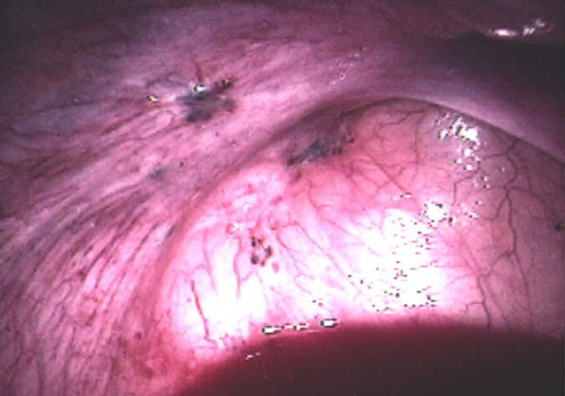
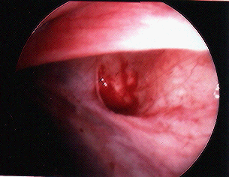
According to Cochrane review Chinese herbal medicine has shown equal results as compared to Gestrinone
(Flower et al. 2009)
Abdominal acupuncture showed significant effect in dysmenorrhoea relief and decreasing CA 125 levels
(Xiang et al. 2011)

Slide 52
Surgery for pain relief
Drug therapy may relieve inflammation and reduce pain in early superficial disease but corrective surgery +/- drug therapy is preferable (Padwick 1999)
Rectovaginal, rectal and uterosacral lesions always need surgery
Endometriomas always need surgery
Abnormal Anatomy and adhesions always need surgery

Slide 53
Role of surgery in pain
Ablation of endometriotic lesions reduces endometriosis-associated pain, outcome is poorest in minimal endometriosis. (level A,RCOG)
There is no evidence that laparoscopic uterine nerve ablation(LUNA) is necessary when ablating endometriotic lesions and LUNA by itself has no effect on dysmenorrhoea associated with endometriosis. (level A,RCOG)
There is currently no evidence to recommend the use of LUNA to treat endometriosis although there is some evidence for the use of presacral neurectomy (PSN). (Cochrane data 2005)

Slide 54
Postoperative hormonal treatment does not produce a significant reduction in pain recurrence at 12 or 24 months and has no effect on disease recurrence. (level A,RCOG)
LNG-IUS, inserted after laparoscopic surgery for endometriosis associated pain, significantly reduced the risk of recurrent moderate–severe dysmenorrhoea at 1 year follow-up. (level A,RCOG)

Slide 55
Deep Infiltrating Endometriosis

Slide 56
Definitive Surgery ? Ovarian conservation
In DIE & severe cases hysterectomy and removal of all visible endometriotic tissue can be done. BSO may result in improved pain relief & reduced chances of future surgery .(RCOG guidelines)
In cases with normal ovaries, hysterectomy with ovarian conservation and removal of endometriotic lesions should be considered.(ACOG guidelines 2010)
TAH-BSO is reserved for women with debilitating symptoms ,who have completed childbearing & other therapies have failed. (ASRM &Canada OBG Society,2010)

Slide 57
Conclusions
Treatment must be individualized
Endometriosis is an inflamatory and Oestrogen dependent condition
Multidisciplinary approach involving pain clinic & counseling should be considered
Drug therapy should be selected considering efficacy, cost and adverse effects
Treat early and agressively by surgical destruction or excision preferably by laparoscope
Drugs targeting this are under trial.
Laproscopy is the gold standard dignostic tool

